Slide 1


GROUP RED
FINAL PHASE OF THE PREDICTION MODEL WORK
JASPREET KAUR
AKSHAY JADHAV
ADITI JAIN
AISHWARYA KATE
RASHMI JAIN
SHIVANI JAIN
13-May-2020

Slide 2





GOAL
JASPREET KAUR
To confirm that the Decision Tree Model (chosen in Phase II) can still score records correctly as True or False using the new final Alarm file.
Apply the final data mining model to the new dataset
“Final” Data Mining Model
New Alarm File
(Unlabeled)
Note the predicted “True” & “False” values and compare with the given information
Given information: 3464 records, with 453 True Values
Manually calculate the final accuracy

Slide 3
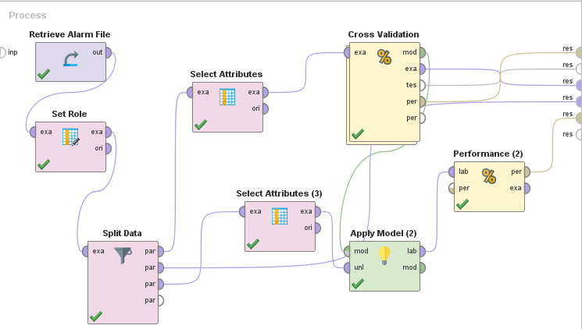
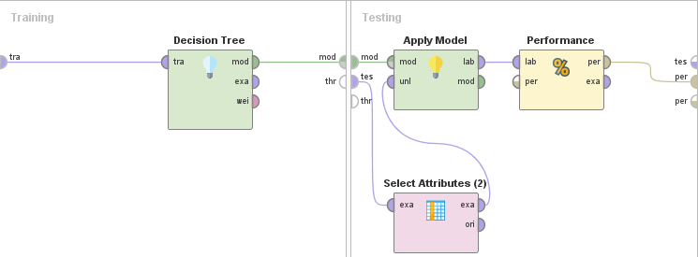
DECISION TREE - FINAL DATA MINING MODEL (FROM PHASE II)
AISHWARYA KATE
We finally apply the adjusted model (in which Timestamp & Violation Type variables are removed) to the validation set (as shown in the process editor)

Slide 4
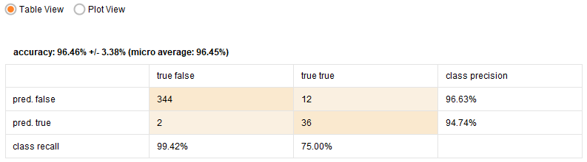
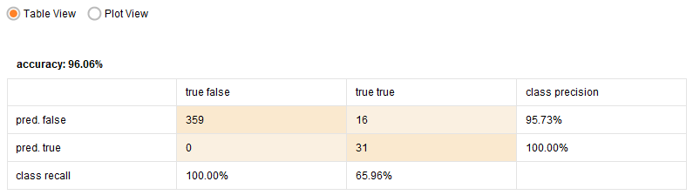
ACCURACY FROM PHASE II
RASHMI JAIN
Test set performance classification result shows 96.46% +/- 3.38% accuracy
Sensitivity or Recall of all positive classes or True Positive Rate (TPR) = 75.00%
Validation set performance classification result shows 96.06% accuracy
Sensitivity or Recall of all positive classes or True Positive Rate (TPR) = 65.96%

Slide 5
DECISION TREE
SHIVANI JAIN
The decision tree model gives us an overall accuracy of 96.46% +/- 3.38% on the test set and 96.06% on the validation set
We’ll apply this decision tree model on the final data set and check if the accuracy is still 96.06% with a confidence level of at least 90%
From Phase II:
Model Accuracy: 93.00% to 96.06%
A good model!
Let’s check!

Slide 6
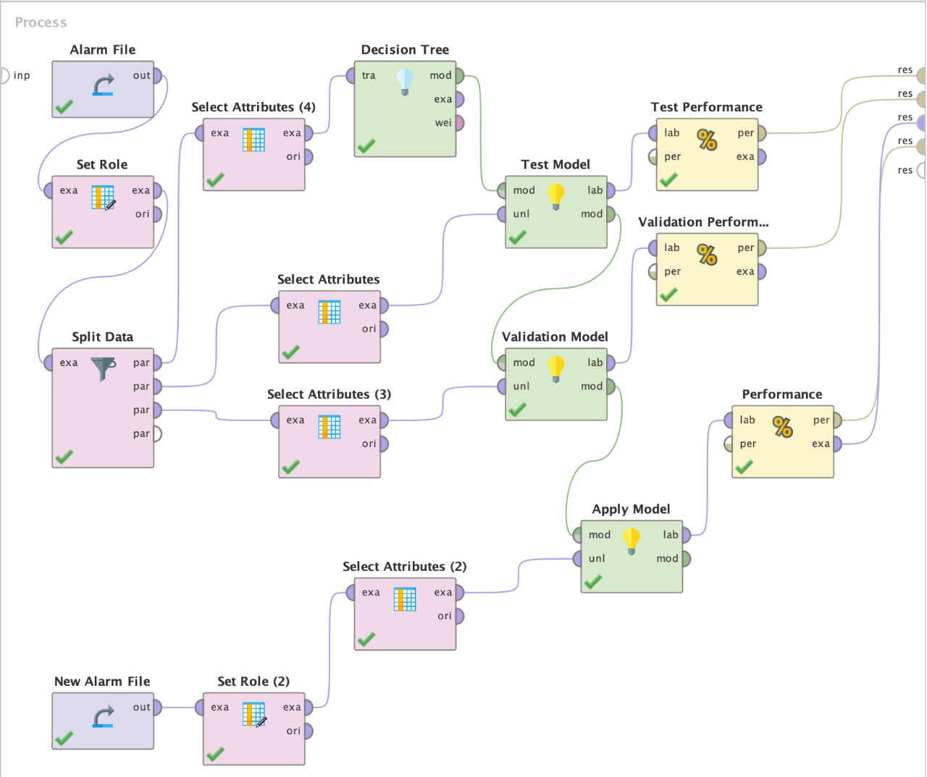
APPLYING THE FINAL MODEL ON THE NEW ALARM FILE
ADITI JAIN
“Retrieve Data” is used to add the new Alarm File
“Set Role” operator is used to tell RapidMiner which is our target
“Select Attributes” operator is used to remove Timestamp and Violation Type variables
“Apply Model” operator is used to apply the final decision tree model on the new Alarm File
“Performance (classification)” operator is used to check if RapidMiner gives us the accuracy

Slide 7
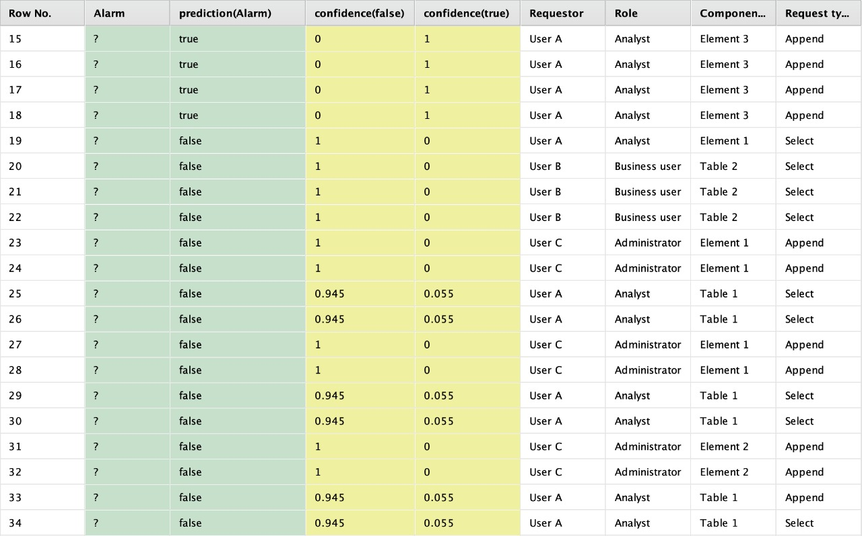
NEW RESULT
AKSHAY JADHAV
RapidMiner gives us the predicted Alarm values on the new Alarm File after we apply the decision tree model on the new dataset
Confidence (false): 97.25% (on an average)
Confidence(true): 100.00% (on an average)

Slide 8
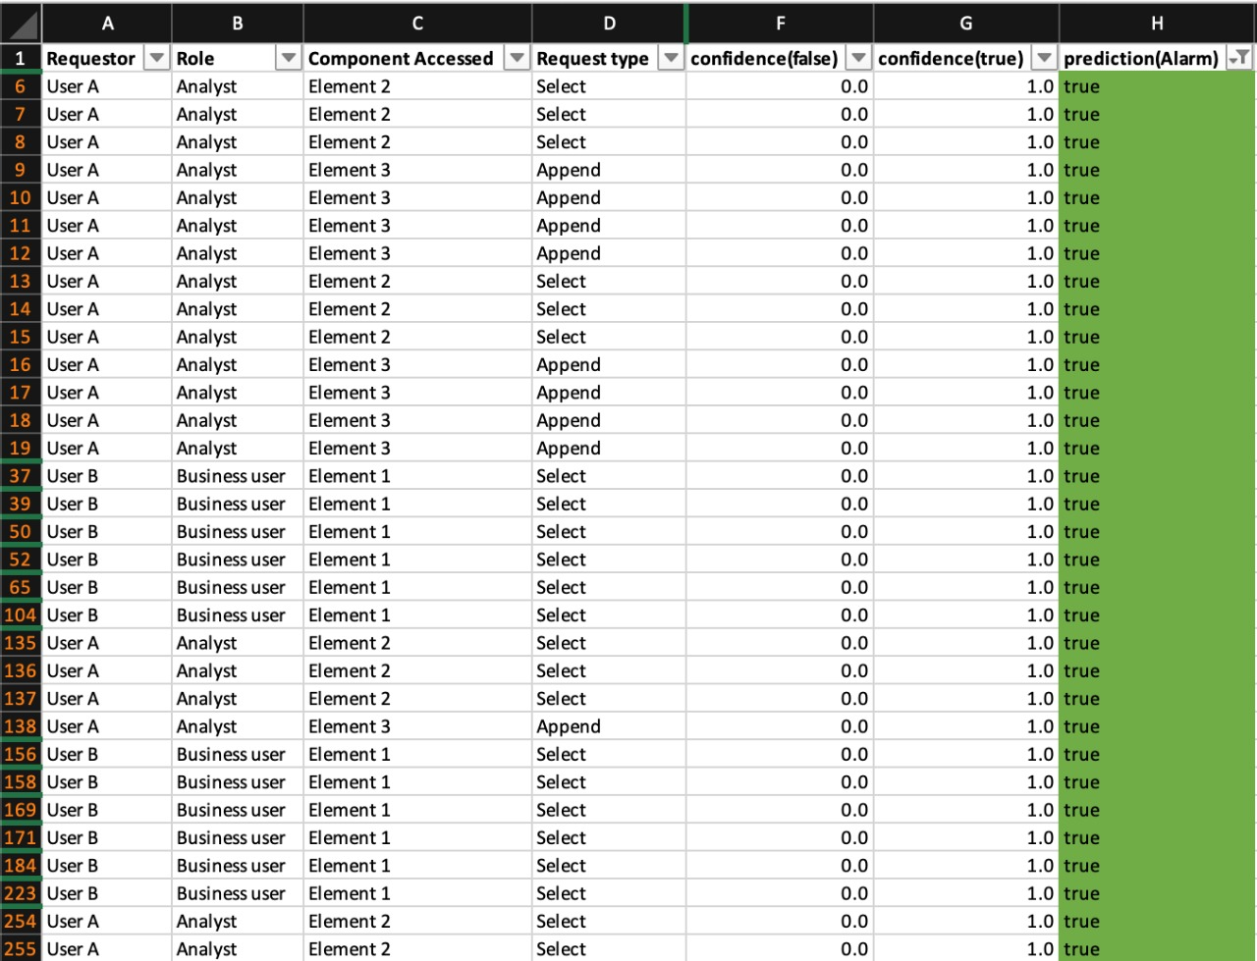
PREDICTED ‘TRUE’ VALUES IN THE NEW RESULT
AKSHAY JADHAV
According to the prediction, there 410 True values, and 3054 False values. (Total Records: 3464)
Let’s calculate the accuracy!

Slide 9
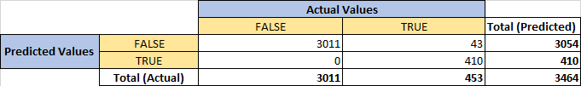
ACCURACY ON THE NEW DATASET
JASPREET KAUR
Here, True Positives: 410
True Negatives: 3011
False Positives: 0
False Negatives: 43
Accuracy = (TP + TN )/ (TP + TN + FP + FN) = 98.75%
Clearly, the accuracy has increased from 96.06% to 98.75%
Fig. 1.1 shows Performance Classification Matrix
Classification Error = (FP + FN) / (TP + TN + FP + FN)
= 1.24%
Here, True Positive Rate (TPR): 90.50%
True Negative Rate (TNR): 100.00%
Clearly, the classification error has reduced from 3.94% to 1.24%

Slide 10


CONCLUSION
JASPREET KAUR
Clearly, the model accuracy has increased from 96.06% to 98.75%. Hence, the Decision Tree model can be considered in production for deployment
The False Positive Rate (FPR) in this model is: 0.00% => FP/(FP+TN) - which is good (should be less than α (= 0.10), which means that the Data Loss Detection Engine/System performs good
The False Negative Rate (FNR) in this model is calculated as => FN/(FN+TP)
= 9.49%
The False Negative Rate (FNR) has reduced from 34.04% to 9.49% which means that there is lesser risk of sabotage to CISO now as compared to the previous rate
In the new result, we find that the maximum number of ‘True’ alarms are generated by Business User (User B) on Element 1 & Element 3 and Analyst (User A) on Element 2 & Element 3.
Model accuracy has increased from 96.06% to 98.75%
Model is good and can be considered for deployment

Slide 11
THANK YOU
JASPREET KAUR

